Slide 1
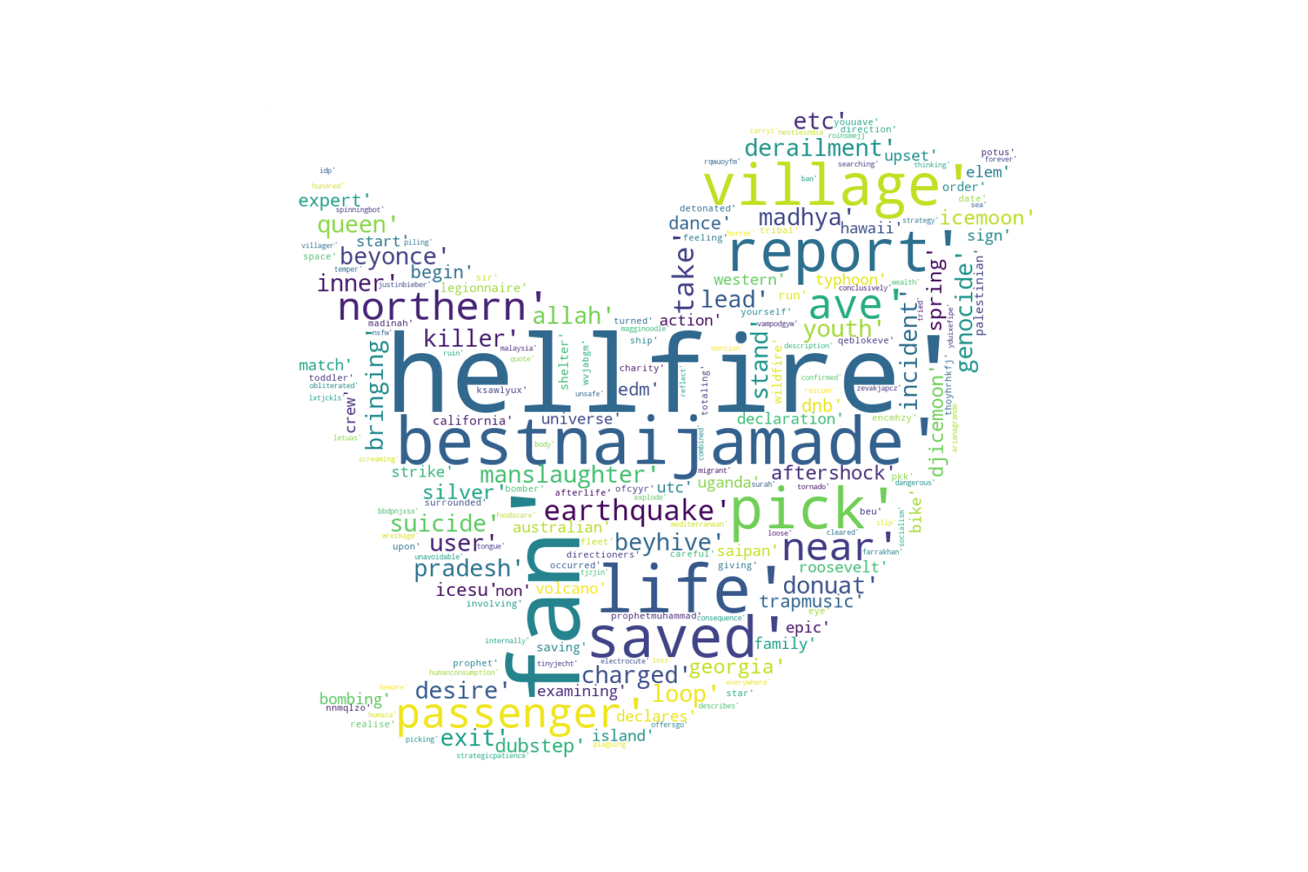
Binary Classification of Tweets
Indrani Banerjee

Slide 2
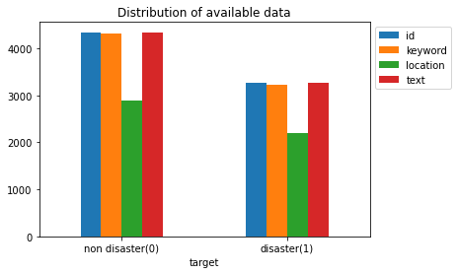
Dataset
7631 Tweets Disaster Tweets: 3271 Non Disaster Tweets: 4342
221 Unique Keywords Missing: 0.8%
Location: cosine similarity of 0.239 33% Missing
Tweets: No missing data
Source: Kaggle Disaster Tweets Dataset

Slide 3
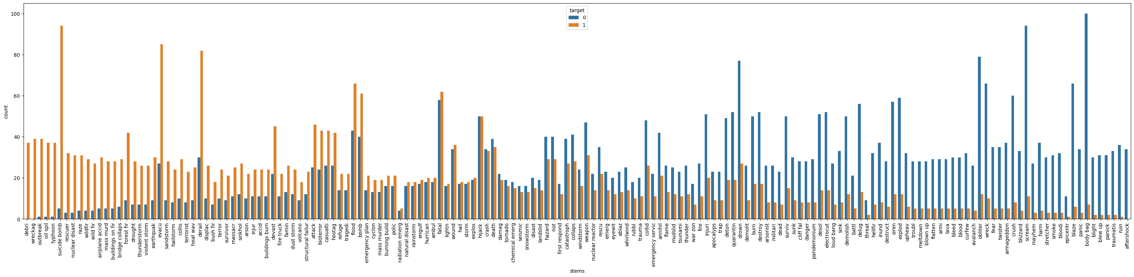
Keywords
Cleaned and then stemmed (Porter Stemmer)
Lion’s share of words seem to be common
Very few are used exclusively in each class
Conclusion: omitting this field for classification

Slide 4
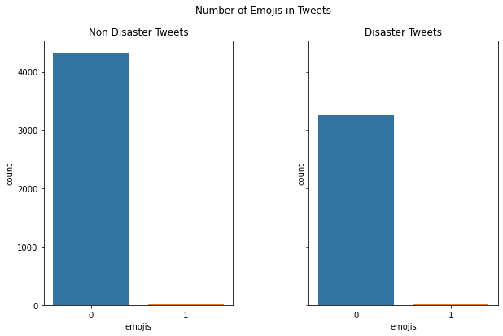
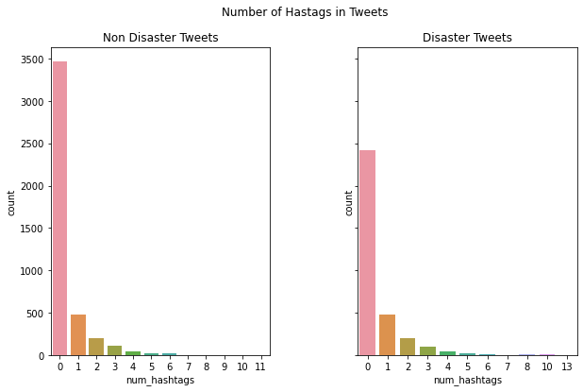
Tweets: Feature Extraction
Hashtags and Emojis - very similar trends : right skew
Data Wrangling -Expanding on Contractions - Emojis and Emoticons -Removing punctuation and special characters -Removal of numerical features -Change to lower case -Custom stop words

Slide 5
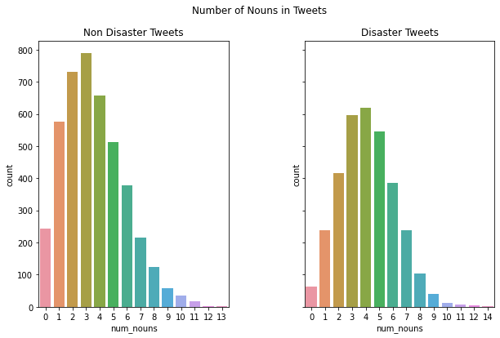
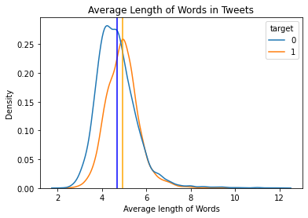
Tweets: Feature Extractions II
Similar trends in number of characters, number of words, average length of words, and the use of proper nouns
Proper nouns: right skew

Slide 6
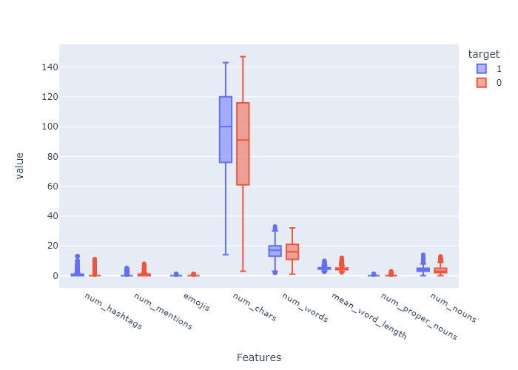
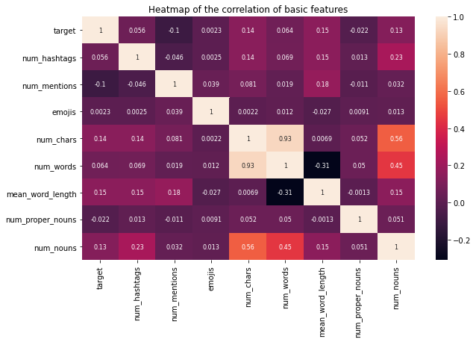
Tweets: Feature Extractions II
Similar trends in number of characters, number of words, average length of words, and the use of proper nouns
Proper nouns: right skew
Conclusion: No strong correlation between the features

Slide 7
Machine Learning Algorithms
Classifier | Parameters | F1 Score | MCC | Accuracy | ROC_AUC | Recall
Logistic Regression | 'C': 10.0, 'penalty': 'l2', 'solver': 'liblinear | 0.75 | 0.58 | 0.79 | 0.78 | 0.68
Naive Bayes Classifier |  | 0.72 | 0.55 | 0.79 | 0.76 | 0.641
XGBoost | 'gamma': 2, 'learning_rate': 0.1, 'max_depth': 20, 'n_estimators': 20 | 0.52 | 0.44 | 0.70 | 0.67 | 0.36
Gradient Boosting Classifier | learning_rate': 0.2, 'max_depth': 8, 'n_estimators': 10 | 0.51 | 0.44 | 0.70 | 0.67 | 0.35
KNN | {'leaf_size': 1, 'n_neighbors': 1, 'p': 1} | 0.57 | 0.38 | 0.57 | 0.64 | 0.32
Random Forest | 'max_depth': 9, 'n_estimators': 5 | 0.29 | 0.30 | 0.62 | 0.58 | 0.17

Slide 8
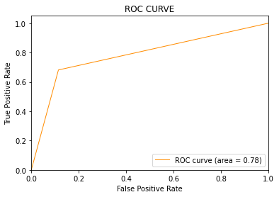
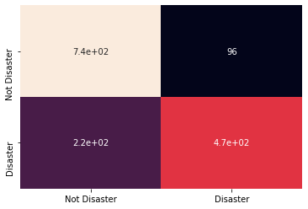
Model Selection I: Logistic Regression

Slide 9
Neural Network with Word Embedding
Google’s Word2Vec was used to create a word embedding model
Activation functions - Hidden Layers : ReLU - Output Layer: Sigmoid
Dropout : 0.2
Loss: Binary Cross Entropy
Optimizer = Adam
Epochs = 10
Validation Split = 0.1
Parameters - the number of features for vector size was varied from 100-300
Models | Parameters | F1 Score | MCC | Accuracy | ROC_AUC | Recall
3 | 200 | 0.61 | 0.178 | 0.61 | 0.579 | 0.35
1 | 100 | 0.43 | 0.167 | 0.6 | 0.57 | 0.34
4 | 300 | 0 | 0 | 0.57 | 0.5 | 0
2 | 100 | 0.01 | 0.0035 | 0.56 | 0.5 | 0.01

Slide 10
Model Selection
Performance: Logistic Regression
Computational Power: Logistic Regression
Self Learning and Future applications: Word2Vec Neural Network
Classifier | F1 Score | MCC | Accuracy | ROCAUC | Recall
Logistic Regression | 0.75 | 0.58 | 0.79 | 0.78 | 0.68
Word2Vec neural network | 0.61 | 0.178 | 0.61 | 0.579 | 0.35

Slide 11
Final Thoughts
Keywords - Possibly integrate into Tweets
Location -low cosine similarity score: explore differences further by looking at popular geopolitical entries
Tweets -Word Embedding for ML models -Neural Network: LSTM and Convolution Neural Networks, vary batch size
Possible chat box integration

